Slide 1
Journal of Society for Transportation and Traffic Studies (JSTS. 2015)
Presentation on
An evaluation of flyover-improved intersections:
A case study of airport intersection
Presented by:
  Narabodee Salatoom
Advisor.
  Prof. Dr.- Ing. Pichai Taneerananon (PSU, Thailand)
Thursday 2nd April 2015, Bangkok, Thailand
Notes:
Good afternoon Professors, ladies and gentlemen, My name is Mr.Narabodee Salatoom (my new full name) would like to present the topic of An evaluation of flyover-improved intersections: A case study of airport intersection.

Slide 2
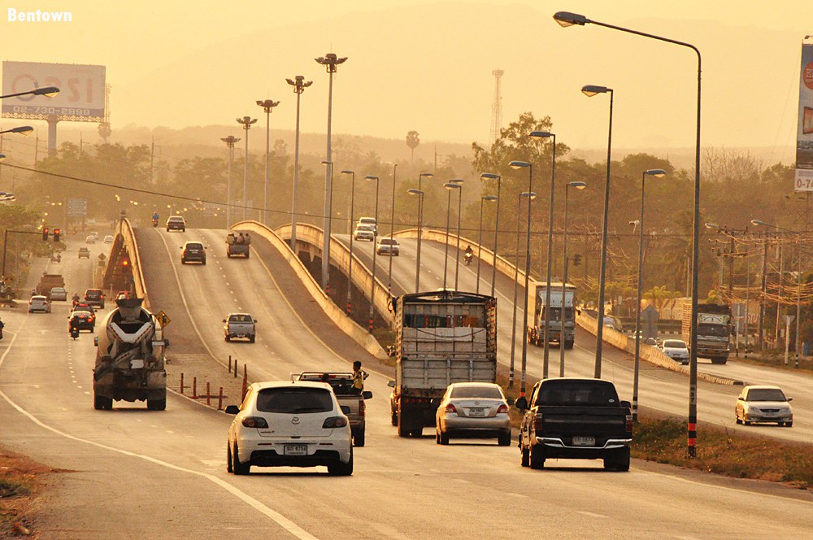
Presentation contents
Issues to study
Objective
Methodology
Data Collection
Project Evaluation
Cost-Benefit Analysis (CBA)
Conclusions
Recommendations
Notes:
This research is one part of my PhD thesis. For today, I have sated the contents to 7 points which are ….

Slide 3



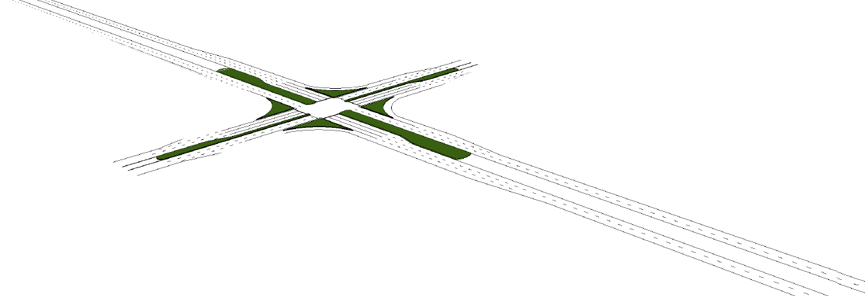

Issues to study (Idea)
To improve intersection,
supporting more traffic volume
reducing traffic congestion
To increase benefit,
Allow to the free flow in two directions on one of the highway-road
Valve of time (VOT)
Vehicle operating cost (VOC)
Flyover-bridge intersection
Issues to study
Objective
Methodology
Data Collection
Project Evaluation
Cost-Benefit Analysis (CBA)
Conclusions
Recommendations
At-grade intersection
Notes:
After the installation of the flyover, it was found that about 45% of traffic diverted to it, the time delay reduced by 34% over the same period. The economic evaluation results show that the net present value equals 361.64 million baht, benefit cost ratio, 1.34 and internal rate of return, 37.58 percent. The paper describes economic benefits of the flyover and presents the performance of the flyover improved intersection and points out the remaining problems under the flyover. Suggestions for improving performance of the existing traffic signal are made using results from SIDRA software.

Slide 4
Issues to study (what the problems?)
A flyover over an existing at-grade intersection is constructed to reduce traffic congestion, to allow for free flow in two directions on one of the main road. However, under the flyover still uses the same control method as the “before” situation; that is the fixed time control plan. And CAN NOT FULLY solve all of the problems!!!
Notes:
After the installation of the flyover, it was found that about 45% of traffic diverted to it, the time delay reduced by 34% over the same period. The economic evaluation results show that the net present value equals 361.64 million baht, benefit cost ratio, 1.34 and internal rate of return, 37.58 percent. The paper describes economic benefits of the flyover and presents the performance of the flyover improved intersection and points out the remaining problems under the flyover. Suggestions for improving performance of the existing traffic signal are made using results from SIDRA software.

Slide 5
Objectives
To study and evaluate the flyover - improved intersections
Time delay ?
Economic cost ?
Problems ?
Issues to study
Objective
Methodology
Data Collection
Project Evaluation
Cost-Benefit Analysis (CBA)
Conclusions
Recommendations

Slide 6
Methodology
(1) Literature Review
Safer Roads,
Intersection design,
Flyover construction project,
Traffic Accident Costing,
Cost-Benefit Analysis, and
SIDRA.,
(2) Case Study selection
At-grade intersection converted
to the flyover improved intersection
(3) Data Collection
Before, during and after
- Traffic movement - Delay
- Physical layout - Accidents,
- Traffic signal - Road safety audit
- Construction cost
(4) Analysis/Evaluation
Efficiency
Road Safety
Effect of flyover on traffic flow
  Traffic volume
  Delay
Project evaluation
Cost-Benefit Analysis
  Benefit of the project
  Economic analysis
Output of SIDRA software
Hazardous zones,
Causes of accidents, and
Accidents costs.
(5) Conclusions
Issues to study
Objective
Methodology
Data Collection
Project Evaluation
Cost-Benefit Analysis (CBA)
Conclusions
Recommendations
(6) Recommendations
Advantage / disadvantage
Improved location
  Physical layout
Flyover limitations
Improved control
  Cycle phase time

Slide 7
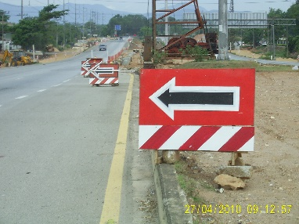

Data Collection
Three periods of time - Collected data
Time period Items | At-grade intersection converted to Flyover intersection
 | Before | During | After
1. Flyover location | Highway route no 43 and highway route no 4135
2. Traffic movement | Yes | Yes | Yes
3. Delay at Intersection | Yes | - | Yes
4. Queue length | Yes | - | Yes
5. Traffic Signal | Cycle time 244 s. | Cycle time 254 s. | Cycle time 224 s.
6. Speed | Avg: 28.5 km/hr. | - | Avg: 45.7 km/hr.
7. Dimension | Yes | - | Yes
8. Conflict points | 50 points | - | 64 points
9. Road Safety Audit | Yes | Yes | Yes
10. Accident statistics | 17 crashes (28 months) | 52 crashes (30 months) | 9 crashes (15 months)
 | 7.3 crashes/year | 20.8 crashes/year | 7.2 crashes/year
11. Construction cost | 249,597,672.5 Baht

Slide 8
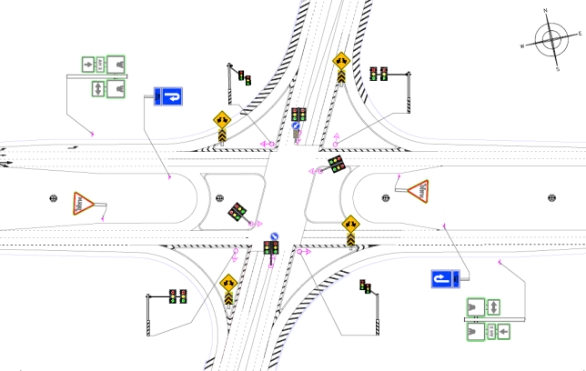
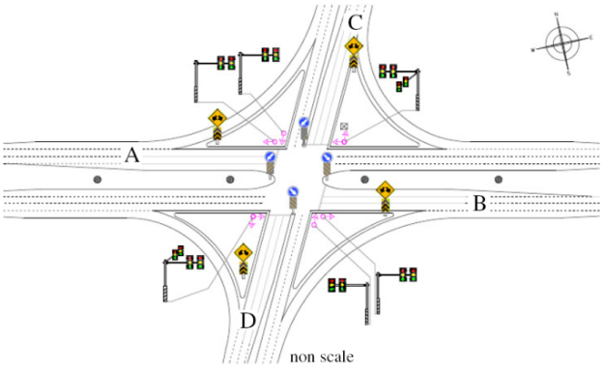
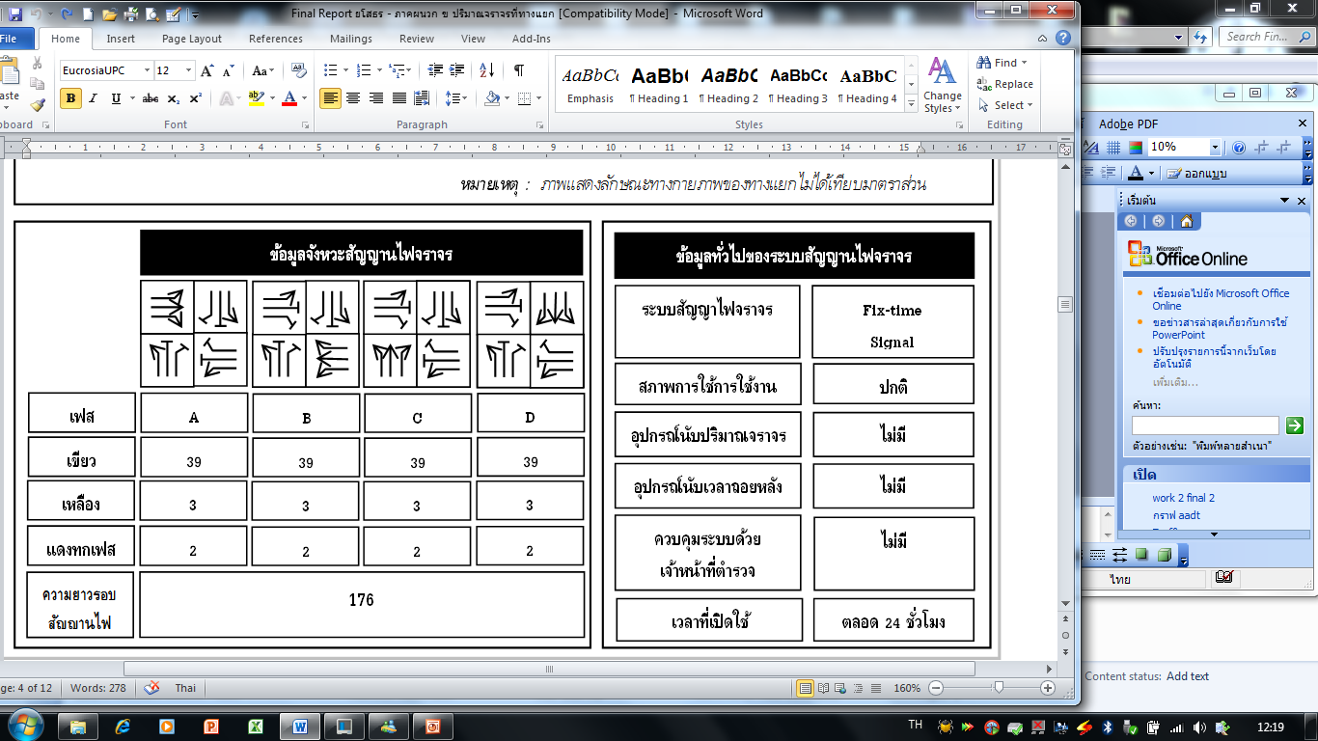
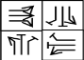
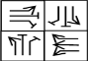

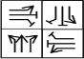
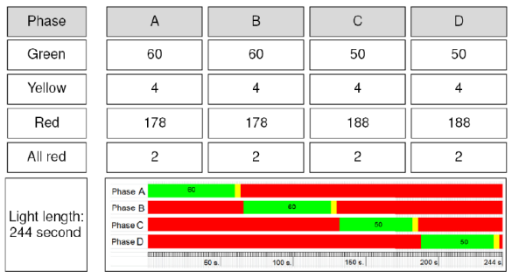
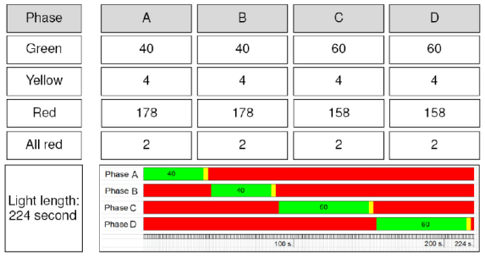
Data Collection
(b)
(a)
244 seconds
C
224 seconds
A
A
B
B
D
Traffic signal for both situations was controlled by fixed time plans and two programs.
The first program is 244 seconds, applied during 0600 to 2100 (4 phases per cycle).
The second program was flashing yellow, applied during 2100 – 0600.
Issues to study
Objective
Methodology
Data Collection
Project Evaluation
Cost-Benefit Analysis (CBA)
Conclusions
Recommendations

Slide 9
Data Collection
Before and After of the TRAFFIC MOVEMENT data
The traffic volume of at-grade intersection in 12 hours is 60,351 PCU (adjusted to the situation of flyover).
The traffic volume of flyover intersection in 12 hours is 64,219 PCU.
  Flow upon the bridge is 29,384 PCU.
The traffic volume increased to 3,868 PCU (6.02%).
The traffic volume on ground level reduced to 25,516 PCU (42.28%).

Slide 10
Data Collection
Before and After of the DELAY data
The delay of at-grade intersection is 535.27 minutes (32,116 seconds)
The delay of flyover intersection is 347.42 minutes
(20,845 seconds).
The average time delay is reduced to 184.85 minutes (34.5%).
Queue length (QL):
  The stopped vehicle ratio at this intersection of at-grade situation is 1.55 : 1 vehicle and flyover situation is 3.16 : 1 vehicle.

Slide 11
Project Evaluation
The project evaluation compares the case with and without the flyover project in order to assess the benefits arising from the project. The benefits include savings in the value of time (VOT), vehicle operating cost (VOC) and saving in cost of accidents.
Vehicle operating costs comprise the cost of fuel, lubricant cost, idling of the engine and operating cost, these correlated to traffic volume, composition, and vehicle speed.
Value of time means the cost (equivalent to money) that is lost due to delay during a trip, but when traffic flow through the intersection is improved after the flyover is operational, the increased intersection efficiency helps reduce travel time and road users can use this time to do other activities.
Accident costs were obtained by using Equation.
Issues to study
Objective
Methodology
Data Collection
Project Evaluation
Cost-Benefit Analysis (CBA)
Conclusions
Recommendations
ACa = | A(F)*MCA(F) + A(Dis)*MCA(Dis) + A(SI)*MCA(SI) + A(LI)*MCA(LI) + A(PDO)*MCA(PDO)
 | t

Slide 12
Project Evaluation
The benefits of the project in terms of VOC and VOT
No. | At-grade to Flyover | Value | Unit | Vehicle operating cost (VOC) | Value of time (VOT)
1 | Under the flyover (intersection) |  |  | Fuel consumption (0.75 Baht/PCU/minute) | Loss of time (84.38 Baht/PCU/hour)
 | Time of all vehicle delay (reduced results) | 187.9 | minute/ day | 187.9 x 0.75 = 140.93 Baht/day | 187.9 x (84.38/60) = 264.25 Baht/day
 |  |  |  | 140.93 x 300 = 42,279.00 Baht/year | 264.25 x 300 = 79,275.01 Baht/year
 |  |  |  | Total = 121,554.01 Baht per year
2 | On the flyover-bridge |  |  | At 60 Km/hr speed (3.99 Baht/PCU/km) | Value of time on highway (120.86 Baht/PCU/hour)
 | Free flow speed of the vehicles in two directions over the bridge | 24,304 | PCU/ day | 24,304 x 3.99 = 96,972.96 Baht/day | 2,025 x 120.86 = 244,741.5 Baht/day
 |  | 2,025 | PCU/ hour | 96,972.96 x 300 = 29,091,888 Baht/year | 244,741.5 x 300 = 73,422,450 Baht/year
 |  |  |  | Total = 102,514,338 Baht per year

Slide 13
Project Evaluation
Annual average accident cost in each situation
Locations Mean cost per accident |  | Number of casualties in 3 situations
 |  | At-grade intersection | During construction | Flyover intersection
Fatal | 5,178,000 | - | 6 | -
Disabled | 6,168,500 | 0.85 | 1.95 | 0.45
Seriously injured | 151,500 | 8 | 23 | 1
Slightly injured | 29,750 | 17 | 39 | 9
Property damage only | 39,000 | 25 | 67 times + 701,400 Baht | 10
DOH damage |  | - | 533,500 Baht | -
Year consider (year) |  | 2.33 | 2.50 | 1.25
Cost |  | 3,405,997 | 20,635,690 | 2,868,060
Saving in accident costs resulting from converting at-grade intersection to the flyover intersection per year = 537,937.85 Baht
Issues to study
Objective
Methodology
Data Collection
Project Evaluation
Cost-Benefit Analysis (CBA)
Conclusions
Recommendations

Slide 14
Project Evaluation
No. | Items |  | Intersection situation |  |  |  | Results
 | Issues | (units) | At-grade | Flyover |  |  | Reduction |  | Increase
1 | Total vehicle delay per day | (second) | 32,116 | 20,845 |  |  | 11,271 | - 34.5%
 |  | (minute) | 535.3 | 347.4 |  |  | 187.9
 |  | (hour) | 8.9 | 5.8 |  |  | 3.1
2 | Traffic volume per day | (PCU/ day) | 60,351 | 64,219 |  |  | - |  | 3,904 | 6.0%
 |  |  |  | PCU | Truck
 |  |  |  | 47,261 | 16,958
 |  |  |  | 73.6% | 26.4%
 | Under the flyover |  | 60,351 | 39,915 (62.16%) |  |  | 20,436 | - 33.8% | -
 |  |  |  | PCU | Truck
 |  |  |  | 32,837 | 7,078
 |  |  |  | 82.2% | 17.8%
 | On the flyover |  | - | 24,304 (37.8%) |  |  | - |  | 24,304 (37.8%)
 |  |  |  | PCU | Truck |  |  |  | PCU | Truck
 |  |  |  | 14,424 | 9,880
 |  |  |  |  |  |  |  |  | 14,424 | 9,880
 |  |  |  | 59.4% | 39.6%
 |  |  |  |  |  |  |  |  | 59.4% | 39.6%
3 | Accident statistics |  | Before | During |  | After | After - Before
 | Fatality (Fal) |  | - | 6 |  | - | - | - | -
 | Disability (Dis) |  | 0.85 | 1.95 |  | 0.45 | 0.01 | 1% | -
 | Serious Injury (SI) |  | 8 | 23 |  | 1 | 6 people | 75.0% | -
 | Slight Injury (SL) |  | 17 | 39 |  | 9 | 0 people | 1.0% | -
 | Property Damage Only (PDO) |  | 25 | 67 times + 701,400 Baht |  | 10 | 22.6% |  | -
 | DOH damage |  | - | 533,500 Baht |  | - | set at 28 months |  | -
 | Months |  | 28 | 30 |  | 15
 | Crash/year |  | 7.3 | 20.8 |  | 7.2 | 0.1 | 1.37% | -

Slide 15
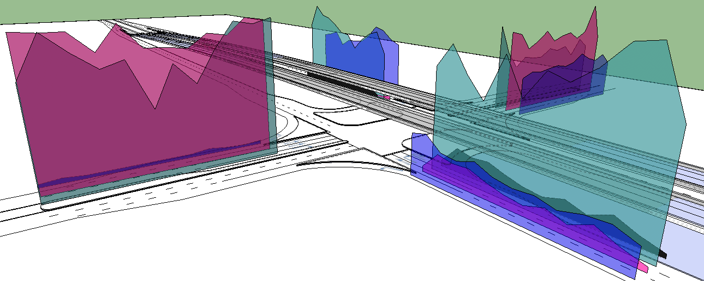
Cost-benefit analysis (CBA)
Net Present Value (NPV): 361,641,982 Baht
In this study used the interest rate per year (i) = 12% (DOH., 2009 and World Bank and Office of the National Economic and Social Development) and
Consider the benefit into the next 10 years (n)
Benefit–Cost Ratio (BCR): 1.34
Issues to study
Objective
Methodology
Data Collection
Project Evaluation
Cost-Benefit Analysis (CBA)
Conclusions
Recommendations
Internal Rate of Return (IRR): 37.585 %

Slide 16
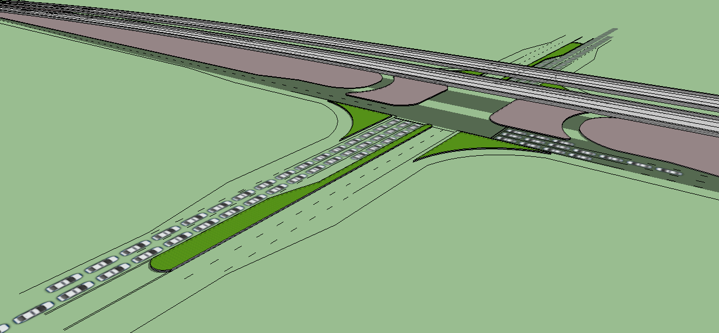
Conclusions
Free flow on the bridge 45.7%
Traffic Volume increase to 6.02%
TV on ground level reduced to 42.28%
Average time delay reduced to 34.5%
Queue length ratio is 1.55 : 1 (before) and
3.16 : 1 vehicle (after).
Issues to study
Objective
Methodology
Data Collection
Project Evaluation
Cost-Benefit Analysis (CBA)
Conclusions
Recommendations
Speed: saving in travel time from increased vehicle speed, especially on the flyover where the speed increased from 29.8 to 52.5 km/hr.

Slide 17
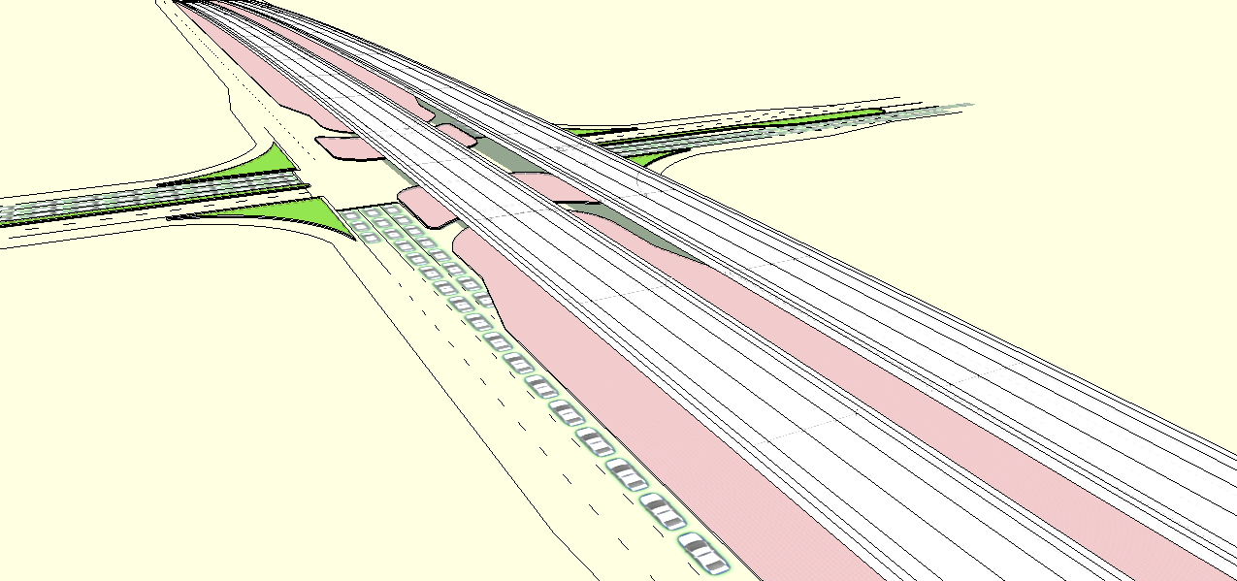
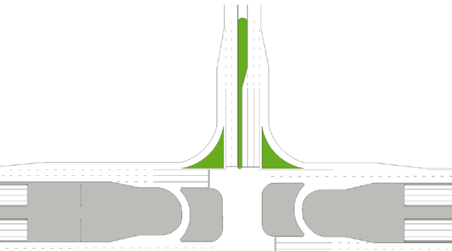
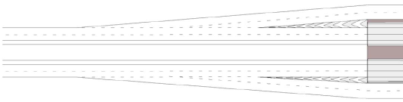
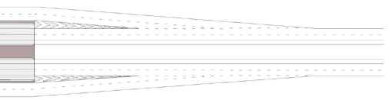
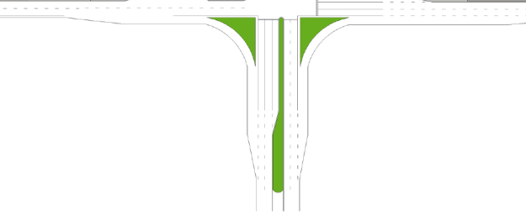
Conclusions
Traffic signalization was controlled by fixed time control plans as situation of at-grade
intersection with two programs a day
Conflict points: 50 points of at-grade intersection
64 points flyover intersection
Accident statistics: at-grade = 7.3 crashes/year, (3.4 million Baht)
during flyover construction 20.8 crashes/year, (20.6 million Baht)
flyover = 7.2 crashes/year, (2.8 million Baht)
Issues to study
Objective
Methodology
Data Collection
Project Evaluation
Cost-Benefit Analysis (CBA)
Conclusions
Recommendations
Diverging Zone
Diverging Zone
Approaching
Approaching
Conflict points area
≈52 m.
Conflict points area
Exiting
Merging Zone
Exiting
Merging Zone
Centra at-grade intersection Zone

Slide 18
Conclusions
Intersection |  | Before | During |  | After Construction
Items | Year | 2009 | 2010 | 2011 | 2012 | 2015 | 2018 | 2019 | 2020 | 2021
Traffic data
Traffic volume | PCU/day | 54912 |  |  | 64219 | 70789 | 78031 | 80606 | 83266 | 86013
On the bridge |  |  |  |  | 24304 | 26791 | 29532 | 30506 | 31513 | 32553
Under the bridge |  |  |  |  | 39915 | 43998 | 48499 | 50100 | 51753 | 53461
Delay | minute | 32116 |  |  | 20845 | 23035 | 25392 | 26230 | 27096 | 27990
Cost
Invesment cost | Baht | -249597672.5
Maintenance cost | Baht/year |  |  |  | -27000 | -27000 | -27000 | -27000 | -27000 | -27000
Accident cost | Baht/year | -3405998 | -20635690 |  | -2868060 |  | -2868060 | -2868060 | -2868060 | -2868060
Saving accident cost | Baht |  |  |  | 537938
Delay cost | Baht/year | -346286 |  |  | -224732 | -248346 | -273756 | -282790 | -292122 | -301762
Saving delay cost | Baht |  |  |  | 121544
Free flow cost | Baht/year |  |  |  | 102.5E+6 | 113.0E+6 | 124.6E+6 | 128.7E+6 | 132.9E+6 | 137.3E+6
Sum | Baht/year | -3.8E+6 | -270.2E+6 |  | 99.4E+6 | 109.9E+6 | 121.4E+6 | 125.5E+6 | 129.7E+6 | 134.1E+6
Cash Flow | Baht | -3.8E+6 | -138.9E+6 | -274.0E+6 | -185.2E+6 | 42.1E+6 | 221.0E+6 | 271.7E+6 | 318.5E+6 | 361.6E+6

Slide 19
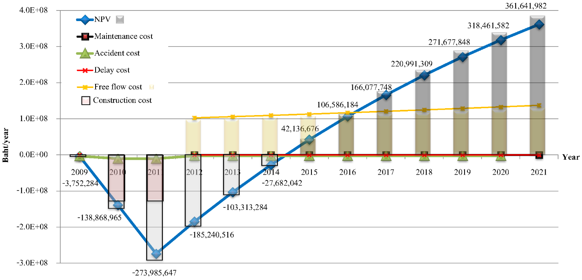
Conclusions
Project evaluation : Vehicle operating cost (VOC) saving was 29.13 million baht,
Value of time (VOT) saving was 73.50 million baht and
Accident cost saving was 0.54 million baht
Cost-benefit analysis (CBA): net present value (NPV) was 361.64 million baht,
benefit cost ratio (B/R) was 1.34 and
internal rate of return (IRR) was 37.58%
((t) = 10 year, (i) = 12%), this project was worthy and efficient for investment.

Slide 20
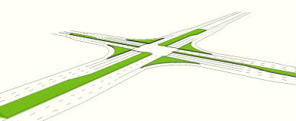
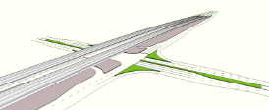
Recommendations
Recommendation data to improve a flyover intersection
Overall, the project is economically worthwhile and can reduce congestion at the intersection. However, the operation of traffic signal has been and is still controlled by fixed time control plans as the previous situation of before the construction of the flyover. Long queue and delay of vehicles especially on the minor highway still exist.
To improve performance of the intersection, shorter optimum cycle times as calculated by SIDRA should be adopted for different time of day.
Issues to study
Objective
Methodology
Data Collection
Project Evaluation
Cost-Benefit Analysis (CBA)
Conclusions
Recommendations
Notes:
This study is one part of author thesis, presented the performance of the flyover and suggested to improve location for providing better in 5 case studies of 29 flyover locations in Thailand.
An at-grade intersection was upgraded with an installation of a flyover at a cost of about 175 million THB, to increase capacity of the intersection and reduce vehicle delay and long queue at the at-grade level, the flyover is one of the methods that supported traffic volume about 25,000 – 45,000 vehicle/day [12].
Benefits terms (the second part study of author thesis: “studied in case of at-grade intersection converting to the flyover intersection”) [21], it was found that about 35-40% of the total traffic volume diverted to the flyover, and despite an increase in traffic volume of +29.46%, at the intersection, the vehicle delays were reduced by 30.41% over the same period, and saving in travel time and vehicle operation cost amount to 421.65 Million THB.
The results of study; However, traffic signalization for both the existing at-grade situation and flyover upgraded situation has been and is still controlled by fixed time control plans, there is still long queue and delay especially on the secondary highways. Hazardous zones in the flyover area spread to more many zones which are at the approaching and exiting zones, at the drainage ditches on a median of roads, at the U-turn under the bridge and at the crossroad under flyover, furthermore, the conflict points increased from 50 points to 64 points. Accident cost is about 9.3 Million THB/year/flyover location, average of accident number is about 30 crashes, injured 30 people and 1 person death per year.
Improving flyover intersection; The SIDRA software (version 5.1) is the indicators which are easily to creating and cheaper for improving, used to calculate the optimum cycle-phase times by depending on the lowest time delay. And improving existing flyover intersection to provide better by using the Road Safety Inspection guideline as shown the recommendations in the table 9. Improved the conclusion and recommendations data

Slide 21
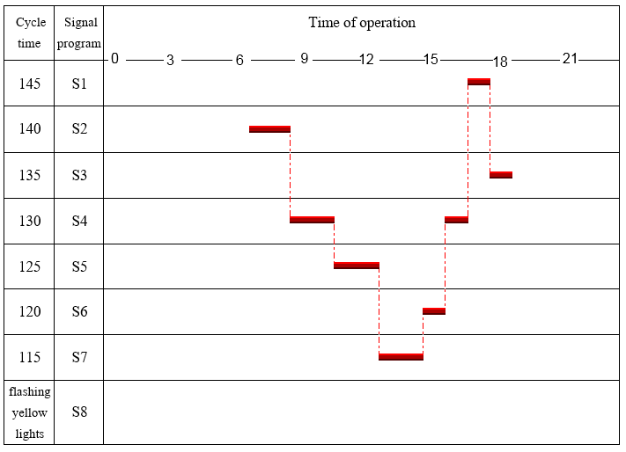
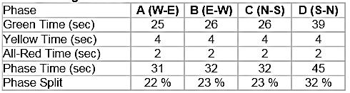
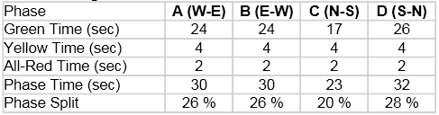
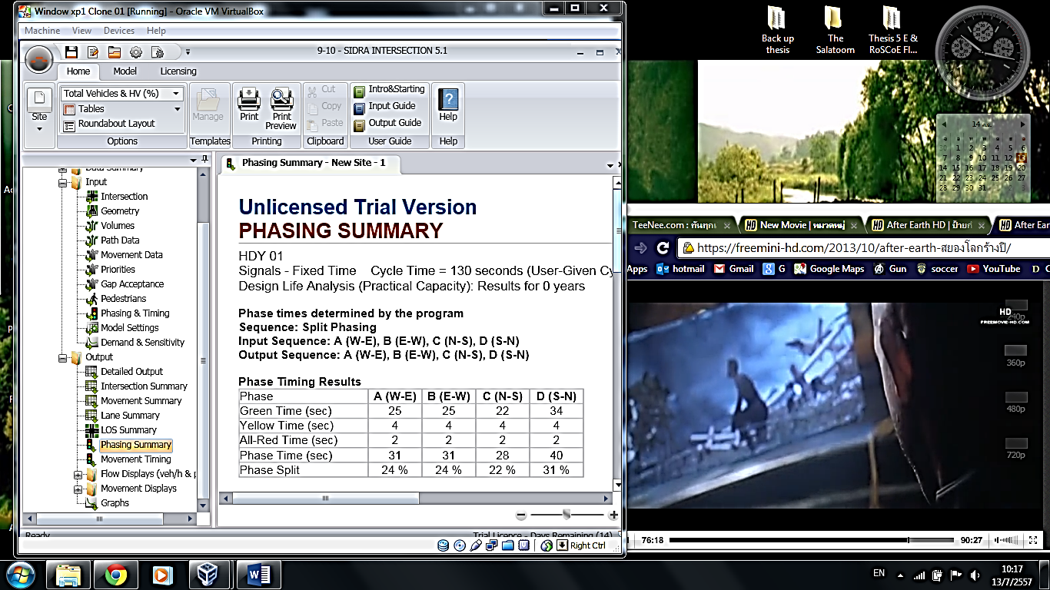
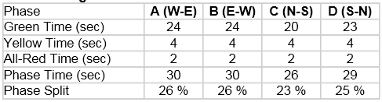
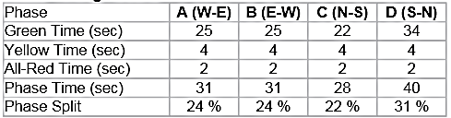

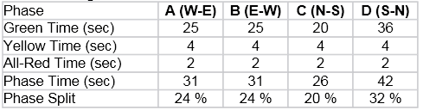

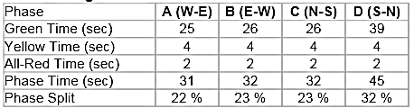


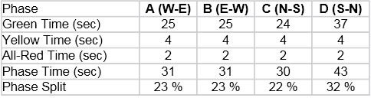
Recommendations
Analysis results from SIDRA
This software is used to analyse the performance of the traffic flow, cycle phase time, delay and level of service (LOS).
Periods of time | New cycle time | Delay (sec) | Phase timing results
7:00 – 8:00 | 140 | 45.5
8:00 – 9:00 | 140 | 45.8
9:00 – 10:00 | 130 | 42.2
10:00 – 11:00 | 130 | 41.5
11:00 – 12:00 | 125 | 40.8
12:00 – 13:00 | 125 | 41.4
Periods of time | New cycle time | Delay (sec) | Phase timing results
13:00 – 14:00 | 115 | 44.1
14:00 – 15:00 | 115 | 48.0
15:00 – 16:00 | 120 | 45.2
16:00 – 17:00 | 130 | 47.5
17:00 – 18:00 | 145 | 61.6
18:00 – 19:00 | 135 | 45.8

Slide 22

Recommendations
Analysis results from SIDRA
This software is used to analyse the performance of the traffic flow, cycle phase time, delay and level of service (LOS).
100
F
Delay (second)
80
60
E
LOS
D
40
20
C
time
Time | 7:00- 8:00 | 8:00-9:00 | 9:00-10:00 | 10:00-11:00 | 11:00-12:00 | 12:00-13:00 | 13:00-14:00 | 14:00-15:00 | 15:00-16:00 | 16:00-17:00 | 17:00-18:00 | 18:00-19:00
 | 64.5 | 67.2 | 64.8 | 58.1 | 57.0 | 61.3 | 67.4 | 75.2 | 86.6 | 83.1 | 103.9 | 66.2
 | 45.5 | 45.8 | 42.2 | 41.5 | 40.8 | 41.4 | 43.3 | 48.0 | 45.2 | 47.5 | 61.6 | 45.8
Difference | 19.0 | 21.5 | 22.2 | 16.6 | 16.2 | 19.9 | 24.1 | 31.9 | 41.4 | 35.6 | 42.3 | 20.4

Slide 23
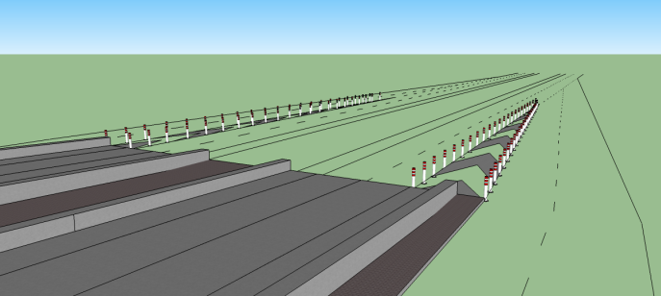
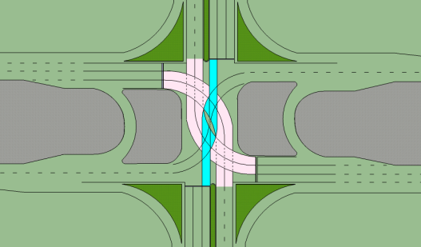
Recommendations
Suggestion to improving an flyover intersection
Items | Intersection
- Recommend to improve the existing flyover intersection | Installed the flexible traffic posts Painted the guidelines for road users
 | - At the beginning/ exiting of the bridge flexible traffic posts should be installed along the line of the nose-ghost island, the direction arrows should be painted on the weaving zones, installation of traffic signs: speed limit sign, give way sign and intersection warning sign.
 | - At the drainage ditches on the median of the main road concrete barriers should be installed to close off the illegal paths
 | - At the U-turn under the bridge, one way traffic control should be used.
 | - At the junction underneath the bridge, guideline should be painted for road users in all directions.
 | - For a typical existing flyover intersection, around 60-80% time delay is on the secondary road, traffic engineer should design a new cycle-phase times of traffic signalization especially the yellow phase-time which should be appropriately designed in accordance with the size of the intersection.

Slide 24
Advantages and disadvantages of the flyover intersection
Items | Disadvantages | Advantages
The bridge over an at-grade level | The visual landscape is obscured, especially the commercial building that located near this area. | Convenient for road users using the bridge, free flow on the bridge
Traffic capacity | Small increase in traffic capacity for the secondary road | Empowered to handle large traffic volume, especially on the main road
Delay & Queue length | The delay and queue on secondary road are quite the same as the situation of the at-grade intersection | Reducing a number of delays and vehicle queues in the direction of the bridge constructed (main road) Saving travel time, increasing vehicle speed, especially, on the main road from 29.8 km/hr. to 52.5 km/hr. (at 85% vehicle speed)
Traffic control | Traffic signalization still uses the fixed-time control plans as the previous situation of at-grade intersection, which does not fully utilize the benefits of having a flyover | Reducing time for waiting at the intersection (by adjusting a new cycle time for flyover situation)
Road Safety | In the flyover area, the hazard zone is spread to more zones, especially at the approaching and exiting zones of the bridge | Reduce traffic conflict points at the junction Reducing rear-end collisions
Cost and benefit | During construction, road accidents and vehicle time delay incurred extra costs Higher maintenance costs | The flyover is an essential part of the highest type of highway, the expressway or freeway. It has cheaper construction cost than other types of grade separations. No land needs to be expropriated.

Slide 25
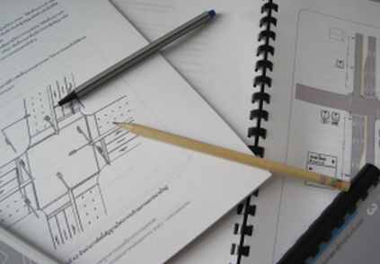
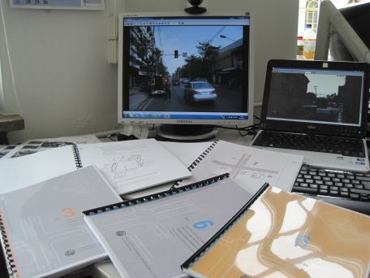
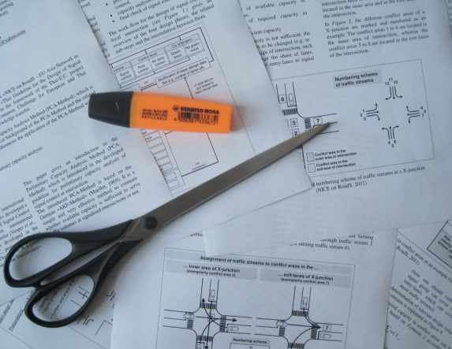
Thank you.
Contact Details
Narabodee Salatoom
PhD student of
RoSCoE - EU-Asia Road Safety Centre of Excellence
Office:
Prince of Songkla University
Sirindhorn Applied Research Building
Hat Yai, 90112
Thailand
Flyover-bridge intersection
Contact:
Phone: +6687 858 / 6993
E-mail: s.weerajak@gmail.com
www.nice-roads.com

